Slide 1
Population Demographics and Management of White Sturgeon in the Sacramento-San Joaquin River System, California
Shannon E. Blackburn
Idaho Cooperative Fish and Wildlife Research Unit
Department of Fish and Wildlife Sciences, University of Idaho
Marty L. Gingras and Jason DuBois
California Department of Fish and Wildlife
Zachary J. Jackson
U.S. Fish and Wildlife Service
Michael C. Quist
U.S. Geological Survey, Idaho Cooperative Fish and Wildlife Research Unit, Department of Fish and Wildlife Sciences, University of Idaho

Slide 2

White Sturgeon
Ecology
Long-lived
Delayed maturation
Periodic spawning
Variable recruitment
Distribution
Status
Declining
Andrew S. Wright
Notes:
WST have unique life history among fishes such as:
Life spans that can exceed 80+ years
WST reach sexual maturity at delayed ages with females maturing anywhere from 10-30 years old
WST do not spawn annually, anywhere from every 2-14 years for female
Variability in successful recruitment
Endemic to large river systems and estuaries west of NA’s continental divide from AK to CA and exist both as anadromous and as a resident freshwater fish
Although White Sturgeon populations are relatively abundant and widespread, alterations to their habitats and overfishing have reduced their distribution and abundance and WST populations are considered to be declining throughout their distribution, including in California…

Slide 3
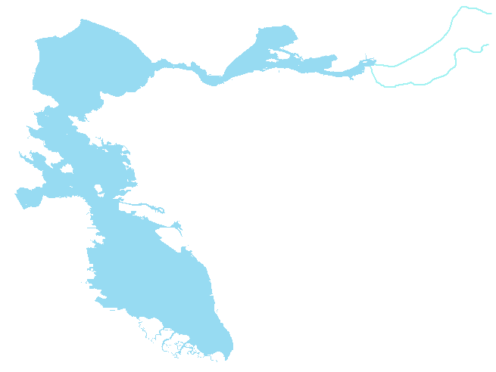
San Pablo Bay
Sacramento River
San Joaquin River
Suisun Bay
San Francisco Bay
Notes:
…in California, White Sturgeon are primarily found in the SFE.
Spend a majority of time in the brackish water of San Fran, San Pablo, and Suisun Bays and use the Sac and San Joaquin rivers to spawn

Slide 4
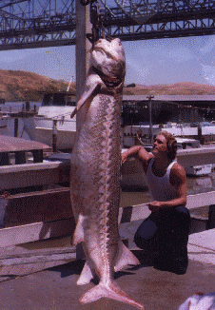
San Francisco Bay Delta-Estuary
Historic commercial harvest
Recreational angling
Exploitation (µ): 2 – 12%
Angler non-compliance
Illegal harvest
Habitat alterations
Habitat reduction
Water operations
Invasive species
Pollution
Notes:
Historically abundant, unregulated commercial fishing in the late 19th century lead to the permanent closure of all fishing in 1917.
A recreational fishery for WST was established in 1954. Since then, the CDFW has been monitoring the population with reported estimates of exploitation across the years varying from 2-11%. However, these exploitation estimates are thought to be biased-low due to incomplete information regarding legal and illegal harvest.
Additionally, urban and agricultural developments in the SSJ has led to widespread habitat alterations resulting in habitat loss, changes to historic water flow and temperatures regimes, introduced piscousivous nonnative species, and reduced water quality.

Slide 5
Age-0 White Sturgeon Abundance Index
The abundance index
Is a relative measure
How is it computed/assessed
What is the source of the data
Is this measure based on a consistent process over the entire period presented?

Slide 6

Management Concerns
This does seem problematic
~50K licensed anglers and
~48K White Sturgeons
Declining population trends
Harvest regulations
Harvest slot length limit
102 – 152 cm fork length
Bag limit: 3 fish per year
~ 50,000 licensed anglers
~ 48,000 White Sturgeon
DuBois and Gingras (2011)
Notes:
These challenging conditions are largely attributed to the declining population trends noticed by mangers in recent years in several monitoring studies. The most concerning include historic lows in CPUE in the CDFW long-term adult sturgeon study. Additionally, recruitment failure has been ongoing for almost 2 decades, with only 2 strong years classes documented in the last 18 years, in 2006 and 2011. With the 2006 cohort fully recruited and the 2011 cohort rapidly approaching full recruitment to the sport fishery, harvest regulations need to be in place that can best protect these year classes.
Currently, a year-round fishery exists for WST in the SFE. Anglers are allowed to keep 3 WST within in the harvest slot length limit per year. This allows for the potential for overharvest as approximately 50,000 anglers per year target WST and there is an estimated 48,000 WST in the system
Although California’s White Sturgeon population has been studied since the 1950s, knowledge of the population demographics remains incomplete and additional information is needed to guide management decisions….

Slide 7

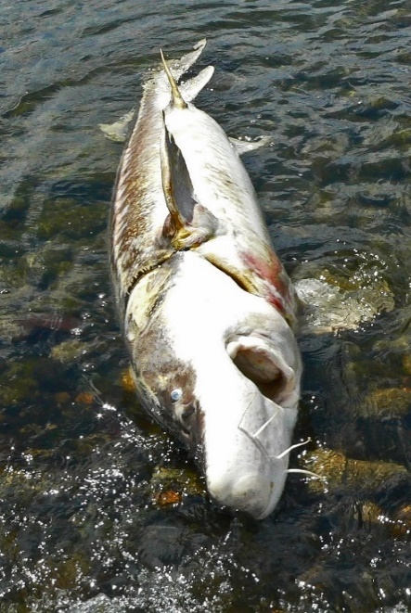

Objectives
Describe population demographics and dynamics
Evaluate different management scenarios
Growth
Natural mortality
Recruitment
Fishing mortality
Notes:
Therefore, the objectives of this study were to:
estimate the population dynamics of White Sturgeon in the SFE
develop models that will help evaluate potential population growth rates under different management scenarios such as bag limits and length restrictions for White Sturgeon in the SFE

Slide 8
Methods
Is data for only a couple of years sufficient to assess the situation?
Is it enough to study the Suisun Bay?
CDFW adult sturgeon study
Suisun Bay
Summer and fall
2014 – 2016
Sacramento River
San Joaquin River
Notes:
To estimate the population dynamics, data were used from the CDFW Sturgeon Study
Sampling primarily took place in SA-SOON Bay during the late summer and early fall of 2014 through 2016

Slide 9

Methods
Is Trammel netting the best way to sample?
What about the sampling intensity and the locations selected, are they adequate?
Where does the criteria of 80cm FL for tagging derive from?
Sampling methods
Trammel netting
Processing
Length
Tagging
Disc-dangler reward tag
Pectoral fin ray removal
Notes:
To collect WST, CDFW deployed experimental trammel net in Suisun Bay. Upon net retrieval, captured WST were checked for PIT tags and measured for fork length (to the nearest cm)
White Sturgeon measuring over 80 cm FL were tagged with a Carlin disc-dangler reward tag inserted through the muscle proximal to the dorsal fin. Each tag was affixed with a monetary value of $20, $50, $100, or $150 and an address in which the angler can mail the tag to claim the reward.
A sub-sample of pectoral fin rays were also collected….

Slide 10

Methods
Age
Size selectivity
SELECT (Millar and Fryer 1999)
Growth
von Bertalanffy
Mortality
Total annual mortality
Exploitation
Reproduction
Maturity
Fecundity
Notes:
We used the pectoral fin rays to estimate ages of individual fish
Because trammel-nets are size selective, we adjusted the population age and length frequency using relative retention probabilities
Using back-calculated-length-at-age, individual growth of WST in the SFE was described using a vonB growth model
Total annual mortality was calculated for age-3 to age-19 using a Chapman-Robson estimator
Because there was no catch of age-0 through age-2, survival rates of these age classes were obtained through the literature.
Estimates of exploitation was based on tag return data from the sturgeon study accounting for angler nonresponse, tag loss and tagging mortality.
Because WST do not exhibit sexual dimorphism and collecting fecundity/maturity information often entails sacrificing the fish, this information was gleaned from previous research….

Slide 11
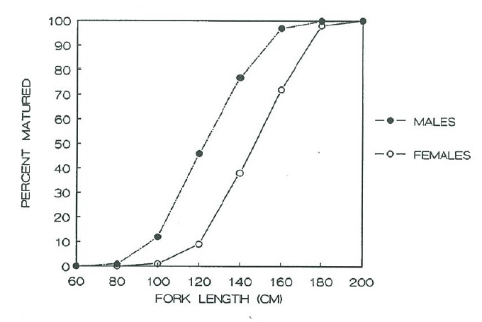
Maturity
They used this data to estimate probability of female sexual maturity but this data is from 1983-1986 is the assumption that this info still is valid adequate?
The plot appears to contain only 8 points of data for each sex, seems insufficient
Chapman (1989)
Notes:
Maturity data were obtained from prior studies on the sexual maturation of WST in the SFE. This figure depicts the percentage of sexually mature male and female sturgeon collected 1983-1986. Using these data, we used logistic regression to estimate the probability of a female being sexually mature.

Slide 12

Fecundity
Mean fecundity at age estimated from data on the Columbia River
So what about spatial effects (Columbia River is not Suisun Bay) and
Temporal effects (has the data used in a different time period applicable for today)
DeVore et al. (1995)
Notes:
Mean fecundity at age was estimated using information on White Sturgeon sampled in the lower, unimpounded Columbia River.
We did not use the fecundity estimate for White Sturgeon in the SFE per recommendation of several experts because the fecundity estimate is weight based and weight data were not collected during recent CDFW sampling efforts….

Slide 13
Fecundity
Fork length (cm) | DeVore et al. (1995) | Chapman et al. (1996)
125 | 105,256 | 92,484
145 | 162,837 | 149,415
165 | 238,087 | 226,861
185 | 333,286 | 328,361
195 | 389,076 | 389,267
Notes:
This figure shows the predicted number of eggs for WST at different fork length using both DeVore et al. and Chapman et al. equations. To use Chapman et al. we converted fork length to kilograms using the standard weight equation for White Sturgeon (Beamesderfer 1993).

Slide 14




Population Modeling
The Ri (reproductive rate for age class i) has many components each with is own uncertainty and assumptions. But seems they treat this complex equation as point estimate when it probably has a large variance.
R_{i} = P_{i} × f_{i} × a × s_{i}
s₀
s₁
…
s₉
s₁₀
…
s₁₉
age 0
age 1
age 10
age 20+
Notes:
Using these demographic data we constructed a female-based Leslie matrix model
Reproductive rates were estimated by P_{i} is the probability of spawning for age-class i, f_{i} is the fecundity (# of eggs) of age-class i, a is the proportion of female offspring (which was assumed to be 1:1, and s_{i} is the survival of age class I
Data for the matrix were available up to age 19 however, it is not uncommon for WST exceed ages of 50 years. As such, an additional age class, 20+, was included so that the life span of WST in the model was not limited to just 19 years.

Slide 15
Population Modeling
This info may be fine, but there is insufficient info to judge the modeling process
Spawning periodicity
25% (4 years)
15% (6 years)
10% (10 years)
Slot length limit
Current (102 – 152 cm)
Smaller (77 – 127 cm)
Larger (127 – 177 cm)
Exploitation
μ : 0.00 – 0.30
Notes:
Spawning periodicity: Substantial limitations remain regarding the reproductive parameters for wild White Sturgeon. Given the best available data, our base model assumes a spawning frequency of 15% of mature female WST in a given year. However, because estimates of spawning periodicity ranges from 2 to 11 years, we modeled spawning periodicities from 5-25%
Harvest slot length limits: We were interested in how different slot length limits affect the population growth rate. As such, we incorporated four different harvest slot length limits, including the current limit as well as a two theoretical limits (i.e., small, medium, large)
Exploitation: And finally, we varied exploitation from zero (no fishing mortality) to 0.30 in 0.1 increments to evaluate the influence of different harvest levels on the population growth rate

Slide 16
Population Modeling
Population modeling
Population growth rate (λ_{G})
Each scenario combination:
5,000 times
20 years
Successful recruitment every 8 years
Notes:
Population projection matrices were used to model population growth and ID age classes with the greatest influence on population growth.
To model population growth, each scenario was combined and simulated 5,000 times over a period of 20 years
The average population growth rate was calculated as the geometric mean of the population growth rate between each time step (i.e., 1 year) over the projection period.

Slide 17
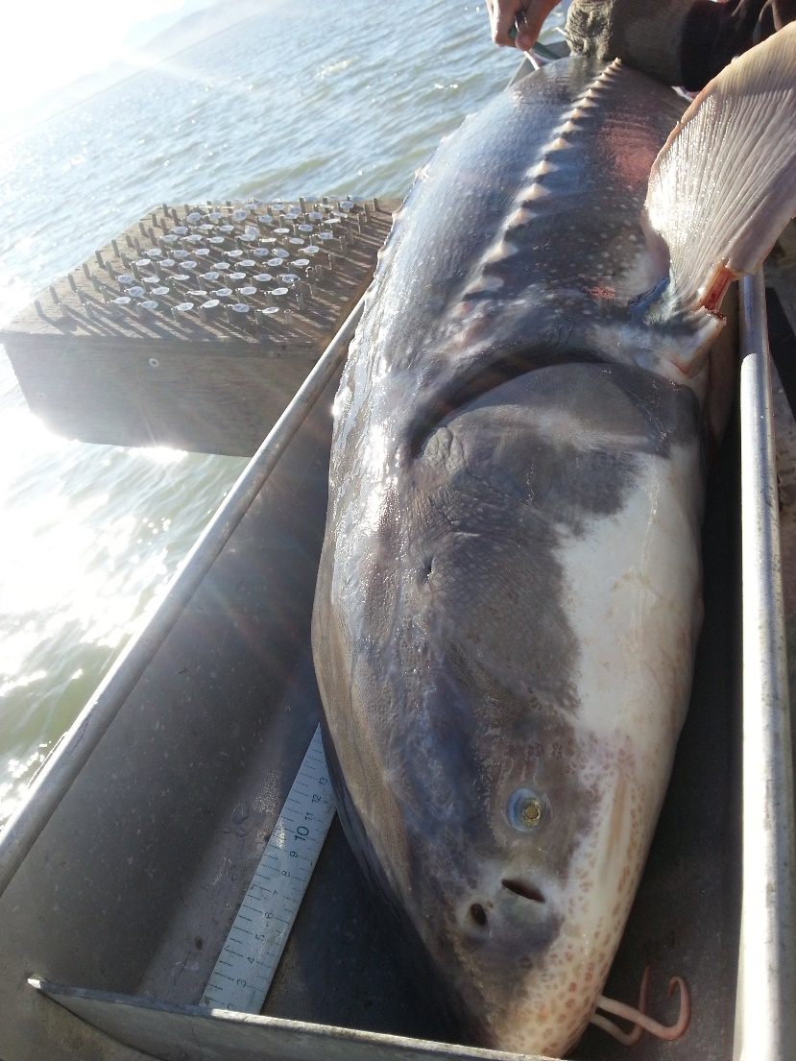
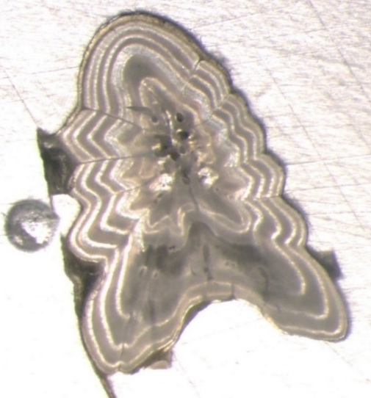
Results
Seems they sub-sampled 374 sturgeons out of 1000 for aging via pectoral fin rays.
Then they must of estimated the age for the remaining 626 (1000-374)
Using some method (Age Length Key)?
CDFW trammel netting
1,000 White Sturgeon
374 pectoral fin rays
Notes:
During the summer and fall months in 2014-2016, CDFW caught a total of 1,000 WST from Suisun Bay. From these, 374 pectoral fin rays were collected.

Slide 18
Length Distribution
This is the observed FL for all 1000 sampled white sturgeons
n = 1,000
Notes:
WST varied in length from 53 to 217 cm fork length (FL) with an average size of 98 cm
After correcting for trammel-net selectivity, peak abundance occurred at age 8
Catch was mainly comprised of immature WST (>100 cm FL) with the greatest proportion of catch between 80 and 90 cm (25% total catch).

Slide 19
Age Distribution
Ages for all 1000 white sturgeons
Sampled, must include the ones 374 they aged via pectoral fin rays plus the 626 they estimated the age via some method such as ALK (age length key)?
n = 1,000
A = 18.7%
Notes:
Corrected Relative length-frequency of WST in SFE
Estimated age varied from 3 to 29 years of age. However, the majority of fish were age 9 and younger. Only 2 fish were estimated to be over 20 years of age.
Total annual mortality was 18.7%

Slide 20

von Bertalanffy Growth Model
VBG models have weaknesses at the extremes (low and high ages)
Because there are usually few data values in the sample at those ages and those extreme age regions are very critical in fitting the correct VBG curve
L_{SFE} = 380 {1-e ^{[-0.027(age+2.36)]}}
Notes:
For example, in the lower Fraser River in British Columbia, WST have an overall slower growth

Slide 21
Lower Fraser River
L_{SFE} = 380 {1-e ^{[-0.027(age+2.36)]}}
L_{LFR} = 370 {1-e ^{[-0.025(age+0.00)]}}
Notes:
For example, in the lower Fraser River in British Columbia, WST have an overall slower growth

Slide 22
Lower Columbia River
L_{SFE} = 380 {1-e ^{[-0.027(age+2.36)]}}
L_{LCR} = 310 {1-e ^{[-0.027(age+2.40)]}}
Notes:
Current WST growth appears to be faster than historic estimates which may be a response to exploitation

Slide 23
Historic SFE (1973 – 1976)
L_{SFE} = 380 {1-e ^{[-0.027(age+2.36)]}}
L_{1970s} = 261 {1-e ^{[-0.040(age+3.63)]}}
Notes:
Current WST growth appears to be faster than historic estimates which may be a response to exploitation

Slide 24
Exploitation
The exploitation rate is estimated using tags (ie self reporting), so this is potentially tainted with nonresponse, false response, loss tags,etc..)
Also the assumption that the $150 tags returned represent 100% response to adjust the returns of the other $ tags.
Notes:
Exploitation (µ) for White Sturgeon was estimated using tags reported harvested during the one year period after tagging for all WST in the slot length limit. This includes WST that at the time of tagging were below the minimum length limit, but grew into or out of the slot using information from the vonB growth model. For example, WST in 2013 recruited to the fishery at 10.2 years and stayed in the harvestable slot for 5.2 years. So all fish tagged between the ages of 9.2 to 15.3 years were considered vulnerable to harvest that year.
The number of tags returned was adjusted for non-reporting with the assumption that tags with the highest monetary value (i.e., US$150) were reported by anglers at a rate of 100%.
Variance estimators account for uncertainty due to the number of tags at large and a low return rate.

Slide 25
Exploitation
Notes:
Exploitation (µ) for White Sturgeon was estimated using tags reported harvested during the one year period after tagging for all WST in the slot length limit. This includes WST that at the time of tagging were below the minimum length limit, but grew into or out of the slot using information from the vonB growth model. For example, WST in 2013 recruited to the fishery at 10.2 years and stayed in the harvestable slot for 5.2 years. So all fish tagged between the ages of 9.2 to 15.3 years were considered vulnerable to harvest that year.
The number of tags returned was adjusted for non-reporting with the assumption that tags with the highest monetary value (i.e., US$150) were reported by anglers at a rate of 100%.
Variance estimators account for uncertainty due to the number of tags at large and a low return rate.

Slide 26
Spawning Periodicity 10%
Need to know more info on what is the specific growth models being simulated here.
Seems like some model that is a function of exploitation, spawning and slot size, but its unclear.
λ_{G}
λ_{G} = 0.954
Notes:
Under a spawning periodicity of 10% of mature White Sturgeon females spawning in a given year, we modeled how the population growth rate might vary under three different slot length limits. In this scenario,

Slide 27
Spawning Periodicity 15%
λ_{G}
λ_{G} = 0.972
Notes:
Under a spawning periodicity of 10% of mature White Sturgeon females spawning in a given year, we modeled how the population growth rate might vary under three different slot length limits. In this scenario,

Slide 28
Spawning Periodicity 25%
λ_{G}
λ_{G} = 0.984
Notes:
Under a spawning periodicity of 10% of mature White Sturgeon females spawning in a given year, we modeled how the population growth rate might vary under three different slot length limits. In this scenario,

Slide 29
Estimated Population Abundance

Slide 30
2006 Cohort

Slide 31
Elasticity Analysis
survival
survival
survival
Notes:
Additionally, we conducted an elasticity analysis which helps estimate which life stage’s vital rate will have the largest proportional change to the population growth rate. Summed elasticities were greatest for adult (age 10+) survival rates. Thus, in this model, survival rates of the reproductive age classes made the largest relative contribution to lambda compared to the survival rates from birth to sexual maturity. This may be because in populations such as White Sturgeon in the SSJ, high survival rates of older, sexually mature individuals are critical to span lengthy gaps in recruitment

Slide 32
Conclusions
Spawning periodicity
15% is likely most realistic
Slot length limit
Similar λ_{G} between harvest slot length limits
Exploitation
Greatest changes in population growth rates
Notes:
Spawning periodicity: by increasing spawning periodicity, exploitation has less of an influence on population growth rates. Even though we modeled different time intervals, we think that the value of 15% of mature females is the most reasonable valuable given the best available literature. However, even at the highest spawning frequency (once every 4 years) the population growth rate did not approach 1 until very low levels of exploitation
10% decrease resulted in a 5.9% decrease in λ
Slot length limit: Changing the slot length limit seem to have little effect on the overall population growth rates. In these models, smaller sizes appear to be better, but not by much. However, this might due in part to the present age structure of the population and a shift to a smaller harvest slot length limit is not recommended at this time.
Exploitation: reducing exploitation to low levels elicits the greatest response in population growth rates, anywhere from 5-17%, depending on the scenario.
Despite the uncertainty and variability in our data and given what we know these models most likely mimic population trends and it is likely that without intervention WST in the SFE will continue to decline without any changes to the harvest regulations.

Slide 33




Acknowledgements
California Department of Fish and Wildlife
Dr. Russell Bellmer
Mike Harris
U.S. Fish and Wildlife Service
Laura Heironimus
Graham Mytton
Zack Jessee
University of Idaho
Dr. Sophie Gilbert
Elizabeth Ng
Joshua McCormick
Quist Lab

Slide 34
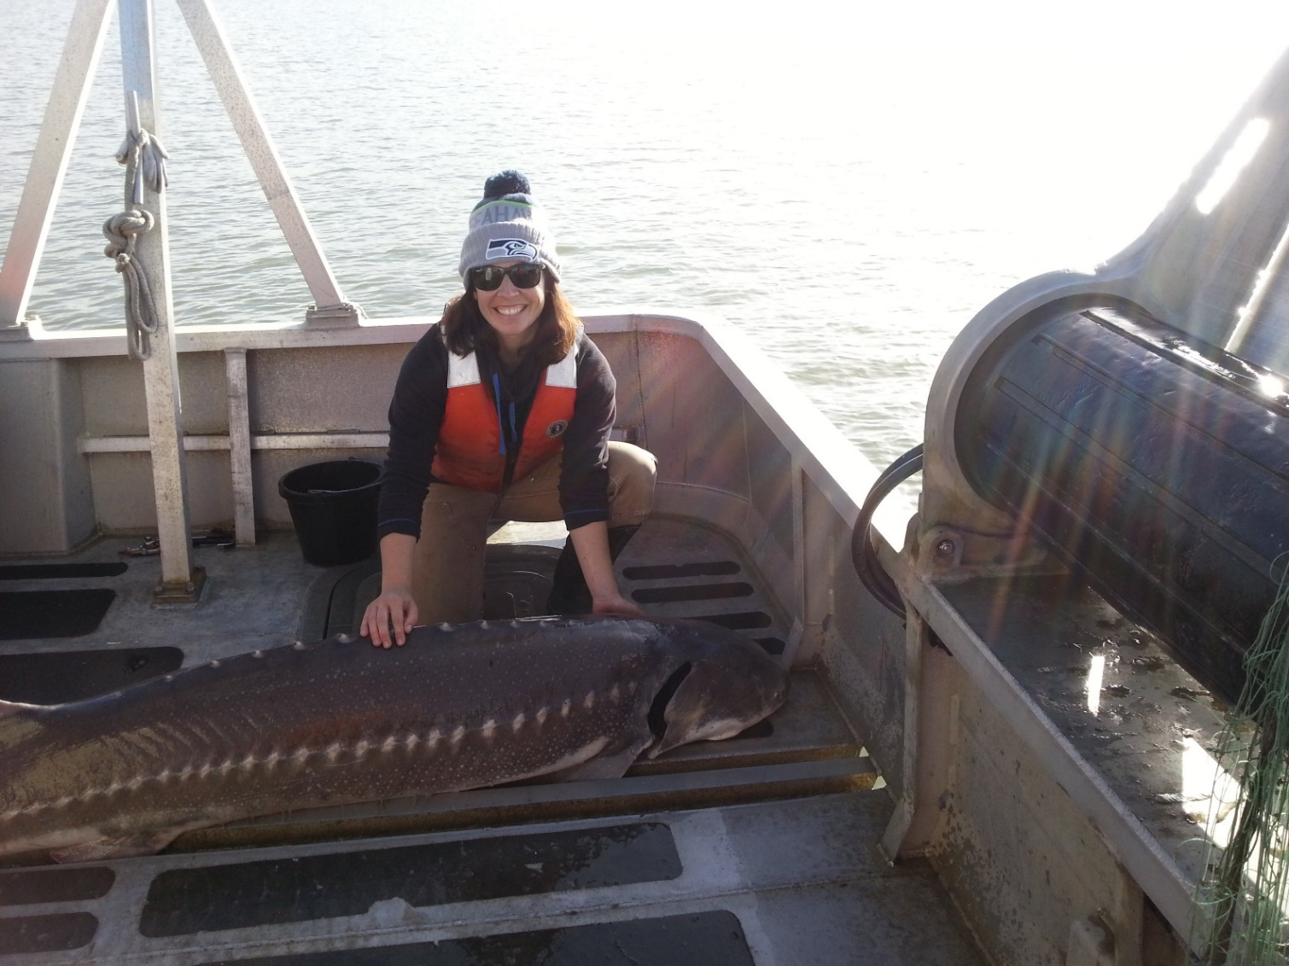
s

